Slide 1




Azure Data Engineering
Enhance your career with Azure Data Engineering skills. Propel your professional growth. Unlock new opportunities with advanced expertise.
Azure Data Engineering skills will elevate your career to the next level.
5 Million
1:1 Personlized
55% Average
Learners
Mentorship
Salary Hike
US: +1-516-422-2003 sales@global-teq.com www.global-teq.com

Slide 2












Azure Data Engineering Program
Jumpstart your Azure data engineering career with expert-led training from top Global Teq faculty. Learn ADLS, SQL, ETL, and more through live sessions with industry professionals.
Hottest Job of 21st Century
5 Million Job Postings
Skill Development
There us a global estimate of 5 million job postings of Data Engineers in 2022
Azure Data Engineers are equipped with various relevant skills that fetch lucrative job offers
Growing Data Engineering Industry
Future oriented Career
50% CAGR in the global data industry
Data Engineering is a budding field; a head start will prove to be beneficial
Popular Degree
High Demand
46% of Data Engineers have a certificate
In 2024, India and the US will face a demandsupply gap of 400,000 Data Engineers
5 Million+
1,000+
400+
Aspiring Active Students
Industry-expert Instructors
Hiring Partners
55%
155+
500+
Corporates Upskilled
Average Salary Hike
Countries’ Learners
US: +1-516-422-2003 sales@global-teq.com www.global-teq.com

Slide 3











About Program
Global Teq Certification in Data Engineering provides comprehensive training in SQL, ADLS and ETL Azure through real-world projects.
Learning Format
Online Boot Camp
7 Months
Live Classes
Career Services
by Global Teq
Global Teq
Certification
Key Highlights
7 Months of Live Sessions by Industry Experts
200 Hrs of Self paced Videos
24*7 Support
Integrated with Global Teq
Flexible Schedule
Soft Skills Essential Training
Career Guidance
One on-One with Industry Mentors
50+ Industry Projects & Case Studies
E-learning Videos from faculty
Lifetime Free Upgrade
Dedicated Learning Management Team
Program Pedagogy
Instructor-led Training
Get trained by top industry experts
Hackathons
Get a sense of how real projects are built
Dedicated Learning Management Team
To help you with your learning needs
Peer Networking and Group Learning
Improve your professional network and learn from peers
Self-paced videos
Learn at your own pace with world-class content
Gamified Learning
Get involved in group activities to solve real-worls problems
Projects and Exercises
Get real-world experience of projects
1:1 Personalized Learning
Hands-on exercises, project work, quizzes, and capstone projects
US: +1-516-422-2003 sales@global-teq.com www.global-teq.com

Slide 4




Who Can Apply for the Course?
Freshers and Undergraduates willing to pursue a career in data engineering
Anyone looking for a career transition to data engineering
IT Professionals
Experienced Professionals willing to learn data engineering
Technical and Nontechnical Professionals with basic level programming knowledge can also apply
Project Managers
Application Process
The application process consists of three simple steps. Candidates have to submit their application. An offer of admission will be made to the selected candidates, and their application will be accepted upon the payment of the admission fee.
SUBMIT APPLICATION Tell us a bit about yourself and why you want to join
1
ADMISSION TEST & APPLICATION REVIEW Clear the admission test and have a personal interview with our interview panel
2
ADMISSION LETTER Shortlisted candidates would be offered the admission letter
3
US: +1-516-422-2003 sales@global-teq.com www.global-teq.com

Slide 5

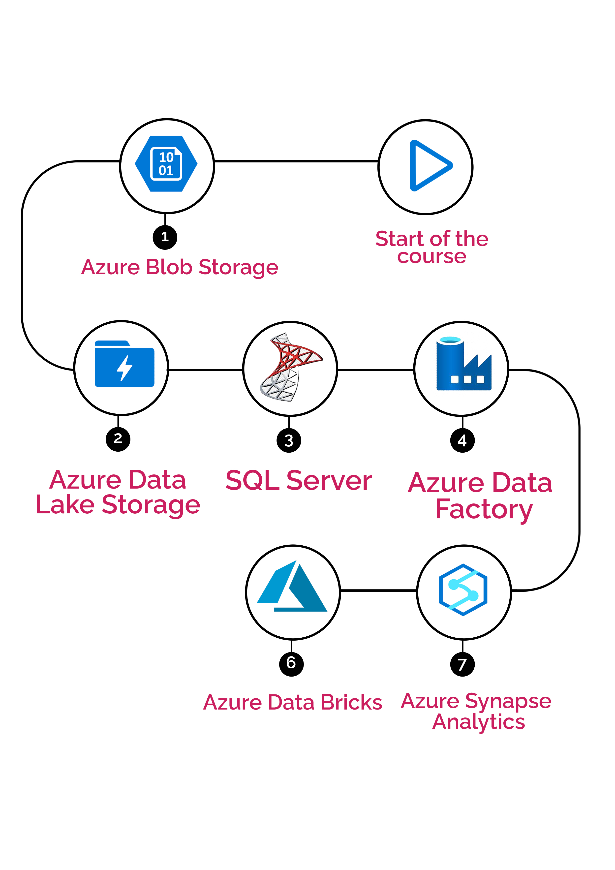
Learning Path
Live Courses
Live Courses
Self-paced
Self-paced Course
AWS Big Data
Power BI
US: +91 9291203306 sales@global-teq.com www.global-teq.com

Slide 6
Program Curriculum
MODULE 1:
Azure Blob Storage
Detail knowledge of Blob
Create a container
Upload a blob to Azure Storage
Create a Blob
List of the blobs in a container
Delete a container
Download the blob to your local computer
Azure Key Vaultgx
Question and Answers
MODULE 2:
Azure Data Lake Storage
Detail knowledge of Data Lake
Create Azure Data Lake Gen 2 Account
Create Folders
Upload data
Secure data
Delete Azure Data Lake
Question Answer
Understand Azure Storage & Create Azure Storage Account
Azure Data Lake Storage (ADLS)
Understand Azure File Share
Lab: Azure File Share
Understand Azure Queue Services
Lab: Azure Queue Services
Understand Azure Table Service
Lab: Azure Table Service
Lab: Azure Storage Explorer
Azure Storage Access Keys and SAS token
Assignment 1: Azure Storage Account
MODULE 3:
Azure SQL Server
Introduction To Azure SQL
Create Azure SQL server and enable private IP
Create Database, table and insert Data
Queries for Azure SQL
Access Azure SQL from SSMS and Query it
Migration of Databases from On Premise to Cloud using the DMA
Migration of Databases from On Premise to Cloud using the Wizard
Secure data
Perform DML activities on Data
Question Answer
MODULE 4:
Azure Data Factory
What is ETL?
ETL vs ELT
Introduction to Azure Data Factory
Activities
Copy Data
Set Variable
US: +1-516-422-2003 sales@global-teq.com www.global-teq.com

Slide 7
Get Metadata
For Each
Append Variable
Delete
Lookup
Stored procedure
Filter
IF
Switch
Execute Pipeline
Transformations in Dataflow
Sort
Filter
Derived
Conditional split
Cast
Surrogate
Aggregate
Pivot
Unpivot
Rank
Window
Union
Lookup
Exists
Join
Integration Run Time
Link Service
Datastore
Connect Datastore
Create Pipeline
Data factory Triggers
Debug Pipeline
Schedule Pipeline
Monitor Pipeline
Alert Rule
Lab
Question Answer
MODULE 5:
Azure Data Bricks
Detail knowledge of Data Bricks
Delta Lake
Configure Data Bricks
Mount Storage
Notebook
Read Data
Store Data
Create multiple Notebook
Create Table and Delta table
User defined functions
Create Master Notebook
Implement Loop
Implement Retry Mechanism
Schedule Notebook
Question Answer
Create Job
Job Clusters
Pyspark Basics
Logging
Integration with Azure Blob
storage
US: +1-516-422-2003 sales@global-teq.com www.global-teq.com

Slide 8
Integration With Azure SQL Storage
Hadoop Introduction
Spark Overview
Lab: Azur Databricks Workspace creation
Lab: Reading File and transformations
Lab: Aggregation, Joins, Sorting
Lab: Spark SQL
Lab: Action vs Transformation, Shuffling, Partitioning
Lab: Azure Databricks Mount ADLS
Lab: ADF and Azure data bricks integration
Lab: Spark Delta tables
Lab: Azure Databricks Cluster management
Lab: Azure Databricks Job Scheduling
Lab: Azure Databricks Streaming
Databricks utilities and library installations
Question Answer
MODULE 6:
Azure Synapse Analytics
Azure Synapse Introduction and account creation
MPP architecture
Design Synapse Pipelines
SQL pools
Spark Cluster
Azure Synapse Lab
Azure Synapse Assignment
Skills to Master
Blob Storage
ADLS
SQL
DML
ETL
Data Bricks
Synapse Analytics
Azure Data Engineer – Developer best practices
Optimizations Techniques
Implementation of End to End Project
US: +1-516-422-2003 sales@global-teq.com www.global-teq.com

Slide 9











Global Teq
Career Services
500+
Webinars
600+
Job Shares
400+
Hiring Partners
55%
Avg. Salary Hike*
What Makes Us Tick
Career-oriented Sessions
Attend 10+ career-oriented sessions
by industry mentors and prepare
your career trajectory
Assured Interviews
Get job Opportunities with Top MNC's
& Startups upon movement to
Placement Pool**
Profile Building
Craft a Data Engineers resume and
LinkedIn profile to make an
impression on top employers
Dedicated Job Portal Access
Get exclusive access to 200 job
postings per month on Intellipaat’s
job portal
Mock Interview Preparation
Prepare with mock interviews
including most asked questions by
top employers
Job Fairs
Job fairs are conducted regularly to
introduce learners to major
organizations
1:1 Mentoring Sessions
Get 1:1 guidance at every step in
your career transition to Data
Engineers
Hackathons
Work in teams and get exclusive
access to hackathons
Learner Reviews
Michael L.
Remote Learner
"Accessing best-in-class courses from the comfort of my home has been a big convenience. I can learn anytime, anywhere, thus allowing me to be balanced in my remote work lifestyle, without giving up on my education goals.”
Emma T.
Skill Builder
"The interactive bits and real-life use cases of these courses keep me engaged and motivated. Since starting, I've completed five certifications, and I feel significantly more confident in being able to tackle complex projects at work."
David M.
Lifelong Learner
"This platform gave me the opportunity to learn incessantly without having to leave my job. With flexibility in time and course options, I stayed ahead in my field and was able to build my expertise continuously."
US: +1-516-422-2003 sales@global-teq.com www.global-teq.com

Slide 10


Global Teq
About Global Teq
Global Teq is a global knowledge enhancement company that empowers thousands of professionals every year with skills needed for new age businesses. We enable continuous learning through certification and training programs in project management, IT service management and quality management. Global Teq believes that education in this fast-paced world is enriching when it is accessible anywhere, anytime. We have partnered with leading technologists to make that a reality. Thousands of professionals and students benefit from our 24×7 access to online course ware that has been developed by SME’s.
Five reasons why we’re the most preferred training partners
• We strive to provide quality education via technological platforms and personal guidance
• Our instructors and trainers are among the best in the industry
• The course ware is constantly evaluated and upgraded to reflect the latest industry trends and practices
• The service team offers unparalleled support, speedy assistance and query resolution
• A dedicated forum to interact with peers, industry experts and other certified professionals
US: +1-516-422-2003 sales@global-teq.com www.global-teq.com

Slide 11

Contact Us
13111 N Central Expy Suite # 150
SG INC CPA, 13111 N Central Expy, Dallas, TX 75243, USA
Call Us: +91 9291203306
Email: sales@global-teq.com
sales@global-teq.com
www.global-teq.com

